Slide 1
Trends in household expenditure
Lessons and opportunities from a crisis

Slide 2
Executive presentation – aims and objectives
Understand trends in household expenditure
Identify opportunities and market sector for future growth
Ensure sustainability through managing risk in different sectors
Determining long-term and short-term priorities in changing market conditions

Slide 3
Our approach
Reviewed annual household expenditure in the UK over the last 40 years
Analysed overall trends and variations
Deeper dive into pre-, during and post-pandemic period
Linked with population and made per capita assessments to test trend analysis

Slide 4
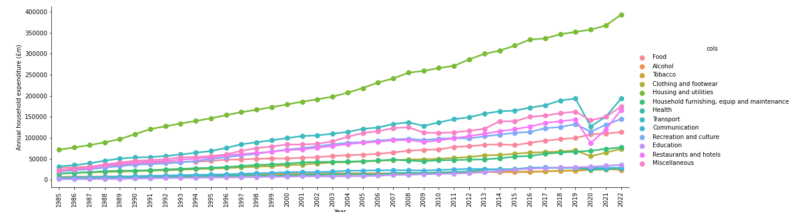
UK annual household expenditure 1985 to 2022
Steady growth through 40-year period, with notable changes during periods of change or crisis, eg:
1997-1998 – change from Conservative to Labour Government
2008-2010 – international banking crisis/change to Conservative government
2019-2022 – Covid pandemic/Brexit

Slide 5
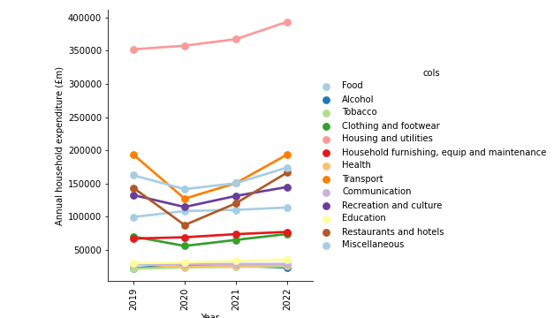
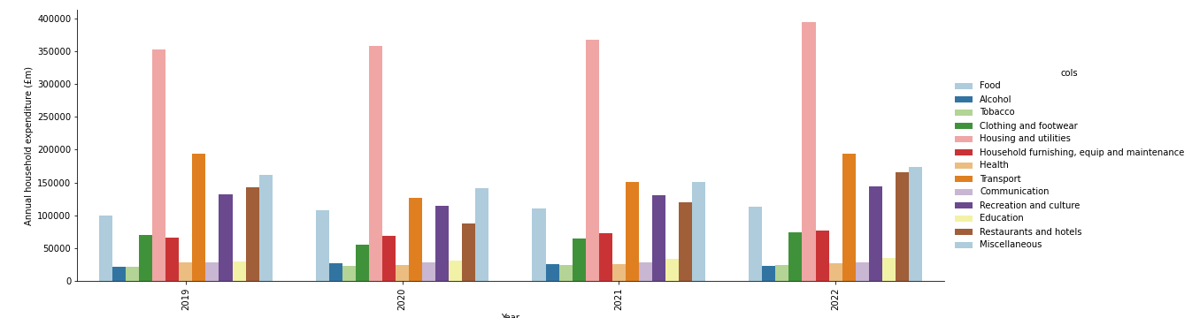
Change/crisis represents opportunity
Not all sectors respond in the same way
Transport, recreation/culture, restaurants/hotels all hit hard
Household equipment, maintenance, food, alcohol fare better

Slide 6
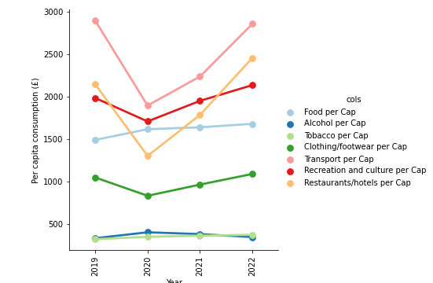
Per capital analysis gives more detail

Slide 7
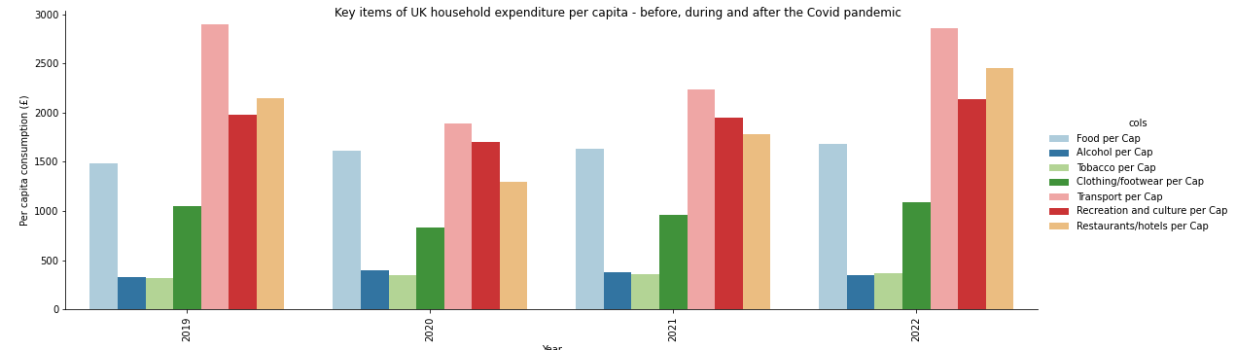
Short-term and long-term opportunities

Slide 8
Conclusions
Food is good for all time
Alcohol helps in a crisis, but is a declining market in the longer term
Clothing takes a hit, but weathers the storm
Transport goes downhill and never makes it back up
Restaurants, hotels, hospitality had major problems, but is bigger than ever
Recommendations
Diversify our food products
Get out of alcohol
Keep away from transport
Clothing is sustainable in the longer term
Invest in restaurants for the longer term, but manage risk with agility

